Slide 1
EV –Charging and Rental
Mini Project II

Slide 2
Project Description
The EV charging station and car booking project is a comprehensive solution designed to make it easier for people to transition to electric vehicles. The project includes the development of a platform that allows users to find and book electric cars and charging stations in their area.

Slide 3
Working
The EV charging station and car booking project will involve several stages of work, including:
Research and Planning
Platform Development
Ongoing Maintenance and updates
Overall, the EV charging station and car booking project will involve a significant amount of work across several stages.

Slide 4
Working
Research and planning:
The project team will conduct extensive research on electric vehicles and the charging process, as well as the needs and preferences of potential users. This research will inform the development of the platform and the selection of charging station locations.

Slide 5
Working
Platform development:
The team will work to develop a user-friendly platform that shows real-time availability of electric cars and charging stations. The platform will also allow users to reserve electric cars and charging stations directly from the platform.

Slide 6
Working
On-going maintenance and updates:
The team will continue to maintain and update the platform and charging infrastructure to ensure that they remain functional and up-to-date with the latest technology and user needs.

Slide 7
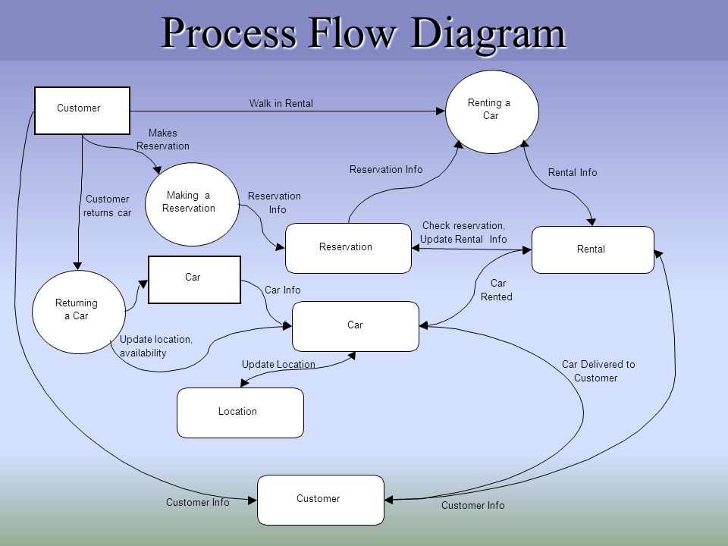
Data Flow Diagram

Slide 8
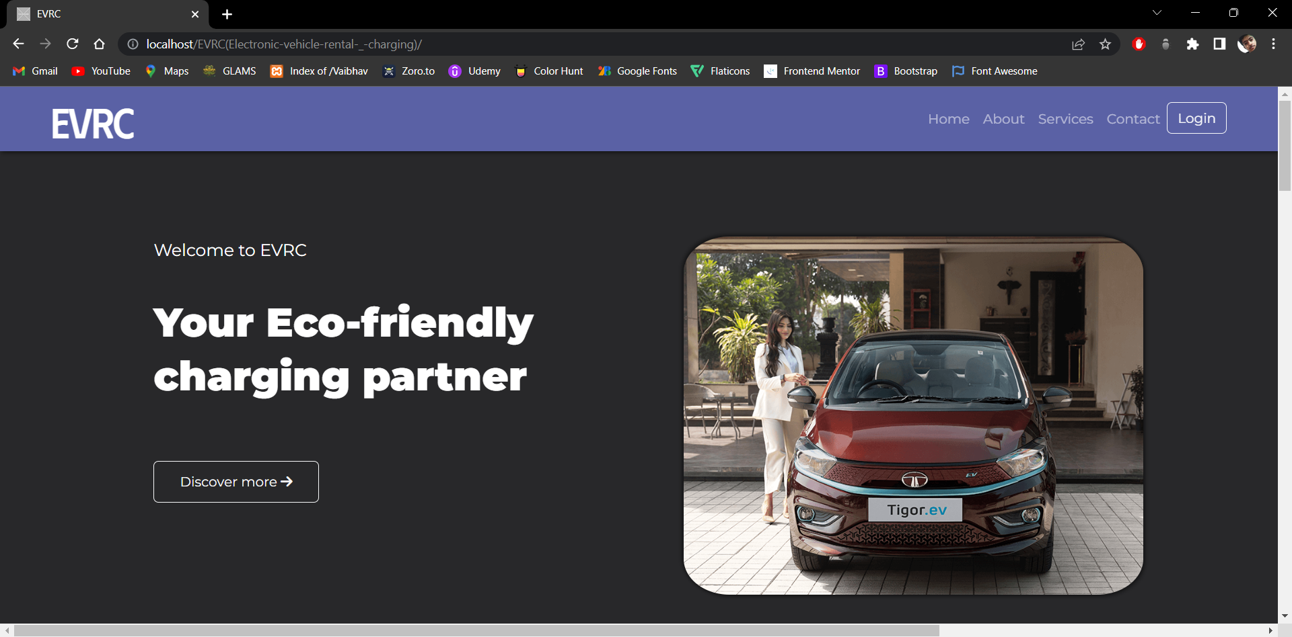
Screenshots

Slide 9

Login Page

Slide 10
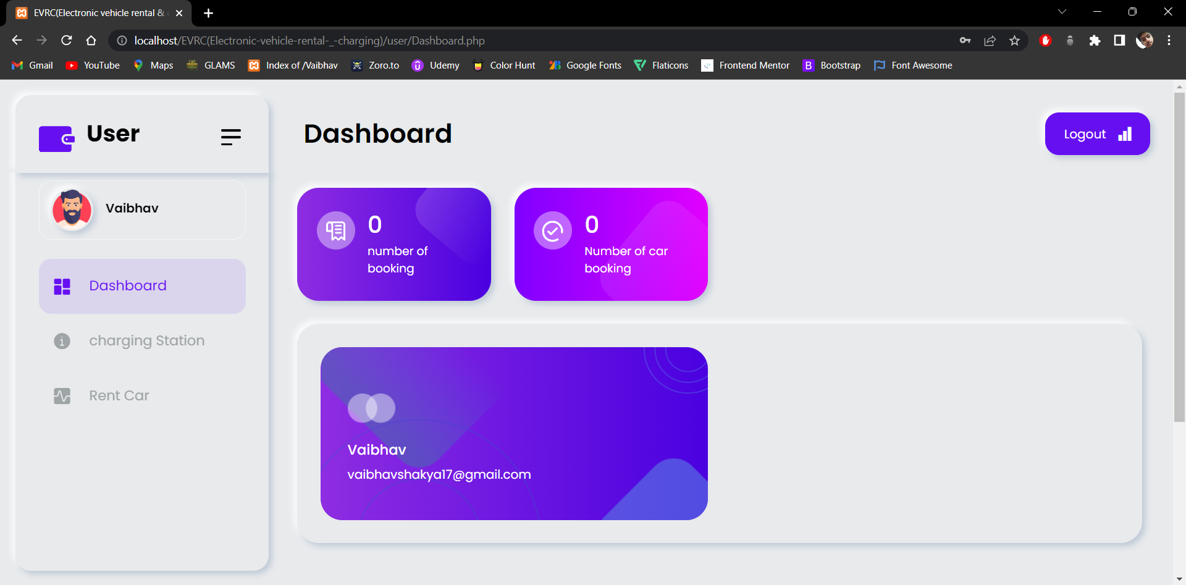
User-Panel

Slide 11
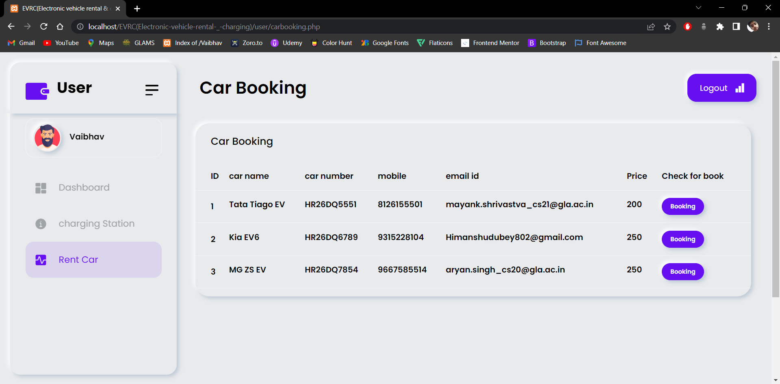
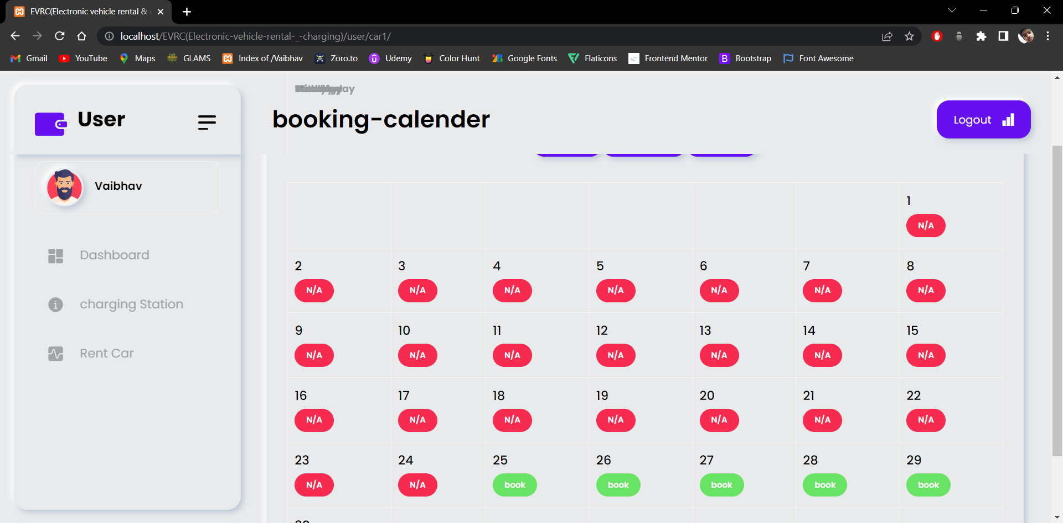
Car Booking

Slide 12
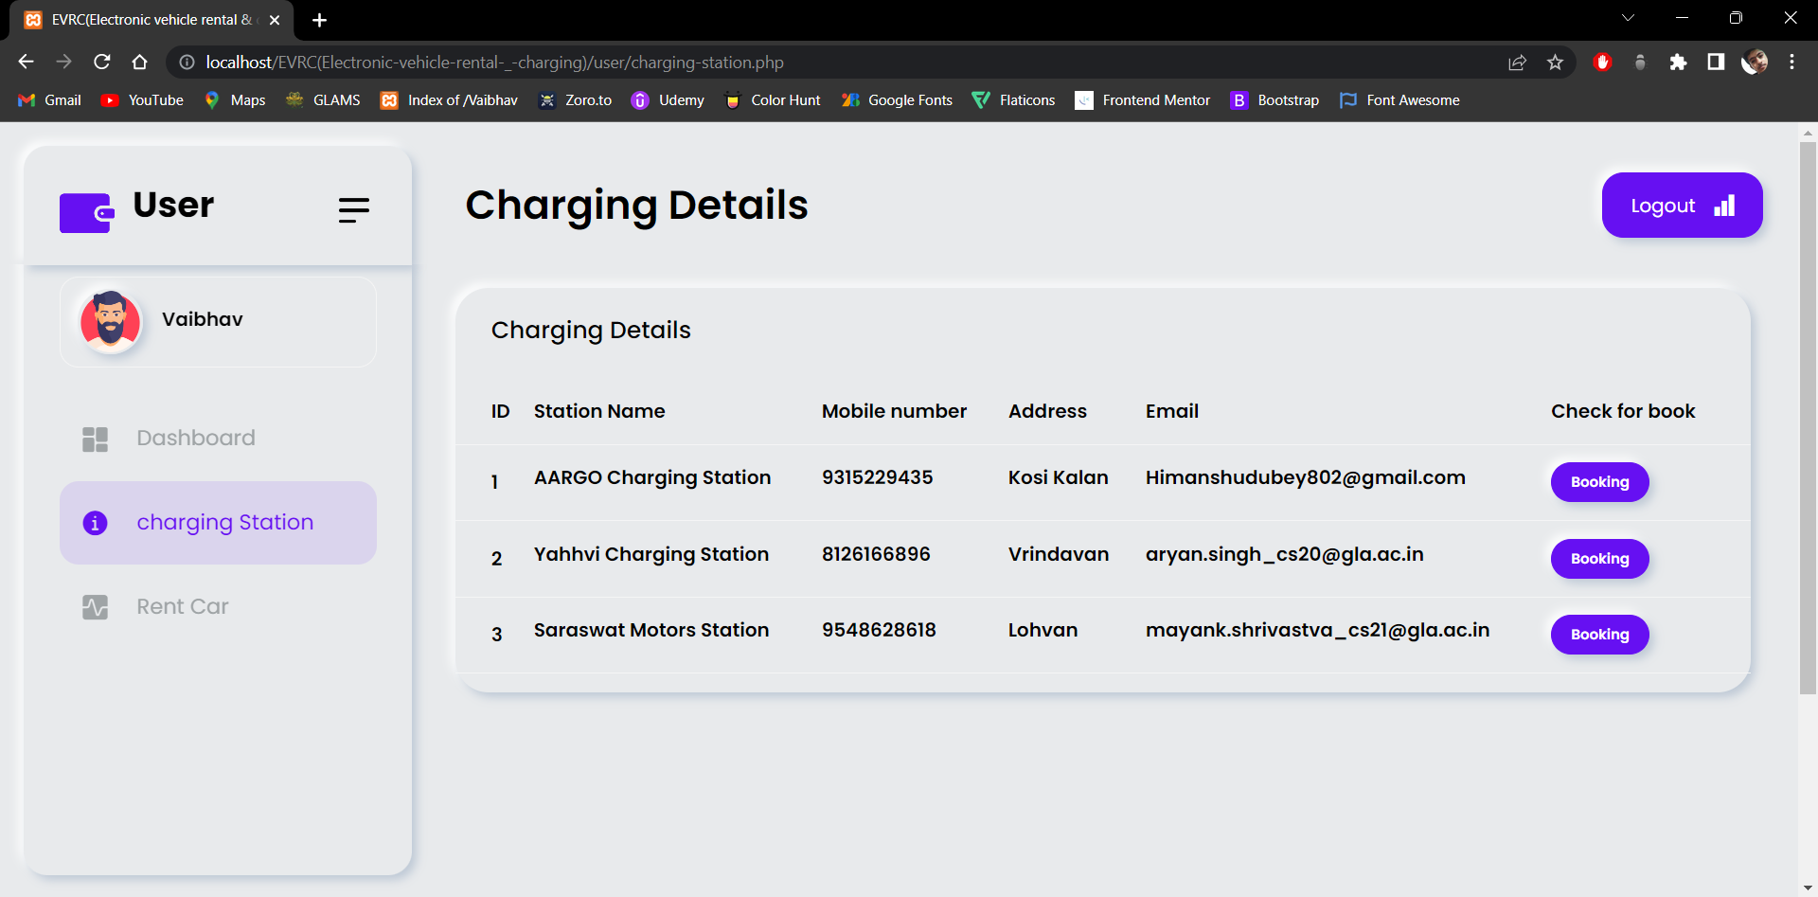
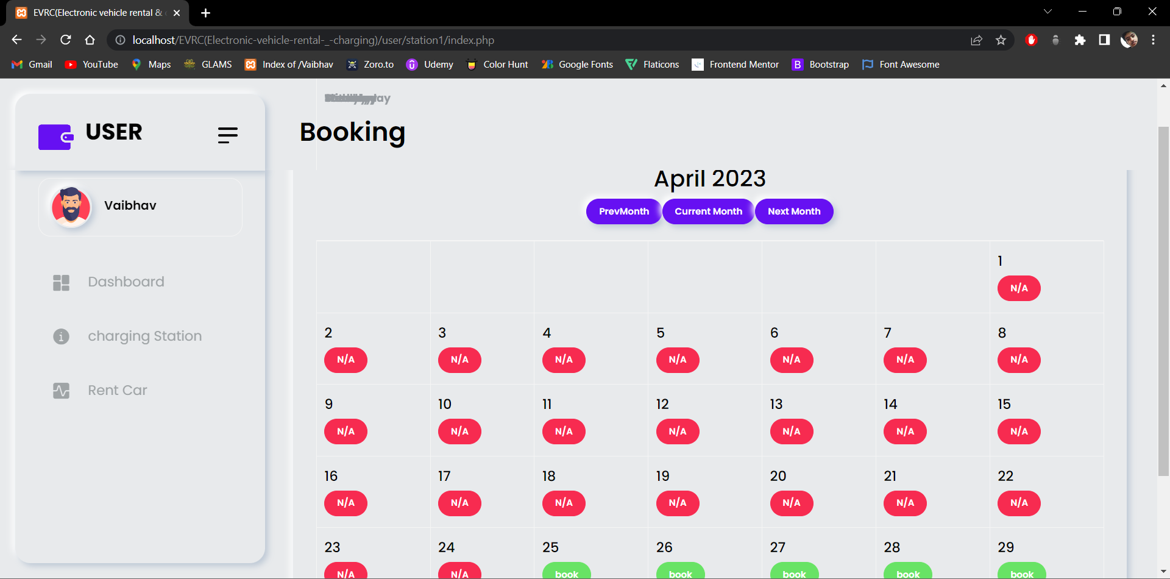
Charging Station Booking

Slide 13
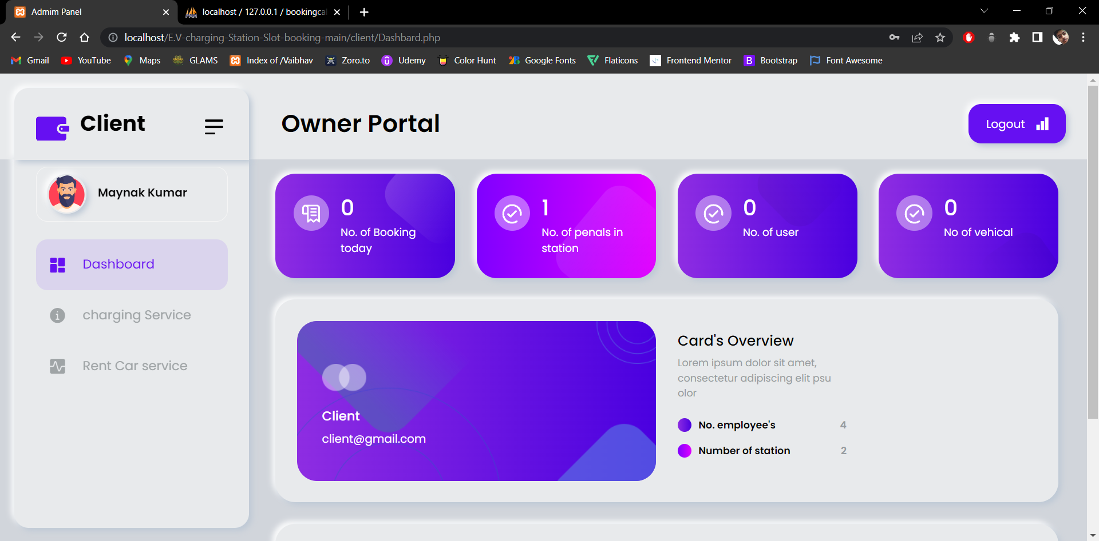
Client Panel

Slide 14
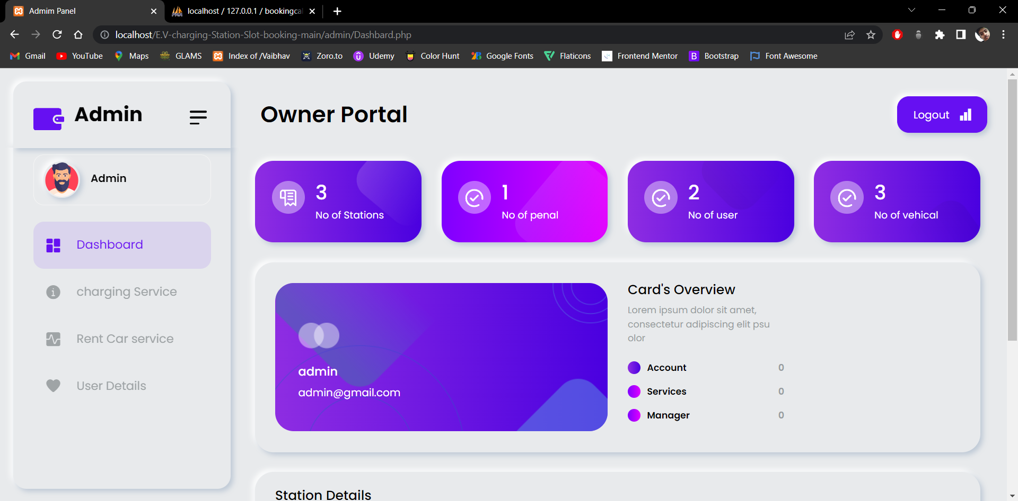
Admin Panel

Slide 15
Thank You
Submitted by:
Shakya Vaibhav (201500639)
Himanshu Dubey (201500293 )
Mayank Kumar Srivastva (2115990010 )
Aryan Kumar Singh (201500153)
Submitted To:
Ms. Madhu (Technical Trainer)

